Slide 1

Heart Failure Prediction
Under the Guidance of,
Prof. Autilia Vitiello
Presented By,
Shilpa Srinivasareddy
Venu Siddapura Govindaraju

Slide 2
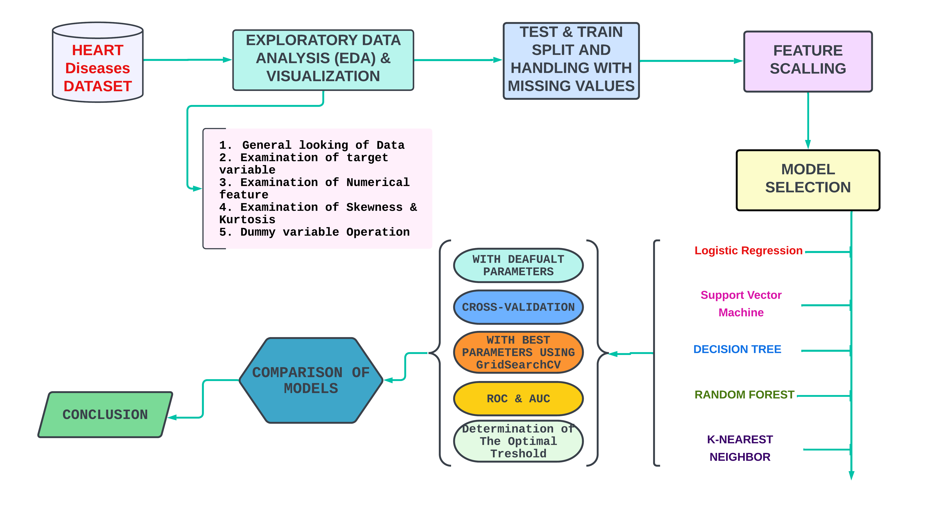
Overview, Workflow & Our goal

Slide 3
01. Data set
1.1 About the data set
1.2 Attribute information
1.3 Data Set Source
1.4 What the problem is?
1.5 Target Variable

Slide 4
1.1. About the data set
Cardiovascular diseases (CVDs) are the number 1 cause of death globally, taking an estimated 17.9 million lives each year, which accounts for 31% of all deaths worldwide. Four out of 5CVD deaths are due to heart attacks and strokes, and one-third of these deaths occur prematurely in people under 70 years of age. Heart failure is a common event caused by CVDs and this dataset contains 11 features that can be used to predict a possible heart disease.
People with cardiovascular disease or who are at high cardiovascular risk (due to the presence of one or more risk factors such as hypertension, diabetes, hyperlipidaemia or already established disease) need early detection and management wherein a machine learning model can be of great help.

Slide 5
1.2. Attribute Information
Age: age of the patient [years]
Sex: sex of the patient [M: Male, F: Female]
ChestPainType: chest pain type [TA: Typical Angina, ATA: Atypical Angina, NAP: Non-Anginal Pain, ASY: Asymptomatic]
RestingBP: resting blood pressure [mm Hg]
Cholesterol: serum cholesterol [mm/dl]
FastingBS: fasting blood sugar [1: if FastingBS > 120 mg/dl, 0: otherwise]
RestingECG: resting electrocardiogram results [Normal: Normal, ST: having ST-T wave abnormality (T wave inversions and/or ST elevation or depression of > 0.05 mV), LVH: showing probable or definite left ventricular hypertrophy by Estes' criteria]
MaxHR: maximum heart rate achieved [Numeric value between 60 and 202]
ExerciseAngina: exercise-induced angina [Y: Yes, N: No]
Oldpeak: oldpeak = ST [Numeric value measured in depression]
ST_Slope: the slope of the peak exercise ST segment [Up: upsloping, Flat: flat, Down: downsloping]
HeartDisease: output class [1: heart disease, 0: Normal]

Slide 6
1.3. Data set source
This dataset was created by combining different datasets already available independently but not combined before. In this dataset, 5 heart datasets are combined over 11 common features which makes it the largest heart disease dataset available so far for research purposes. The five datasets used for its curation are:
Cleveland :303 observations
Hungarian: 294 observations
Switzerland: 123 observations
Long Beach VA: 200 observations
Stalog (Heart) Data Set: 270 observations
Total: 1190 observations Duplicated: 272 observations
Final dataset: 918 observations
Every dataset used can be found under the Index of heart disease datasets from UCI Machine Learning Repository on the following link: https://archive.ics.uci.edu/ml/machine-learning-databases/heart-disease/

Slide 7
1.4. What the problem is ?
In the given study, we have a binary classification problem.
We will make a prediction on the target variable HeartDisease
Lastly, we will build a variety of Classification models and compare the models giving the best prediction on Heart Disease.

Slide 8
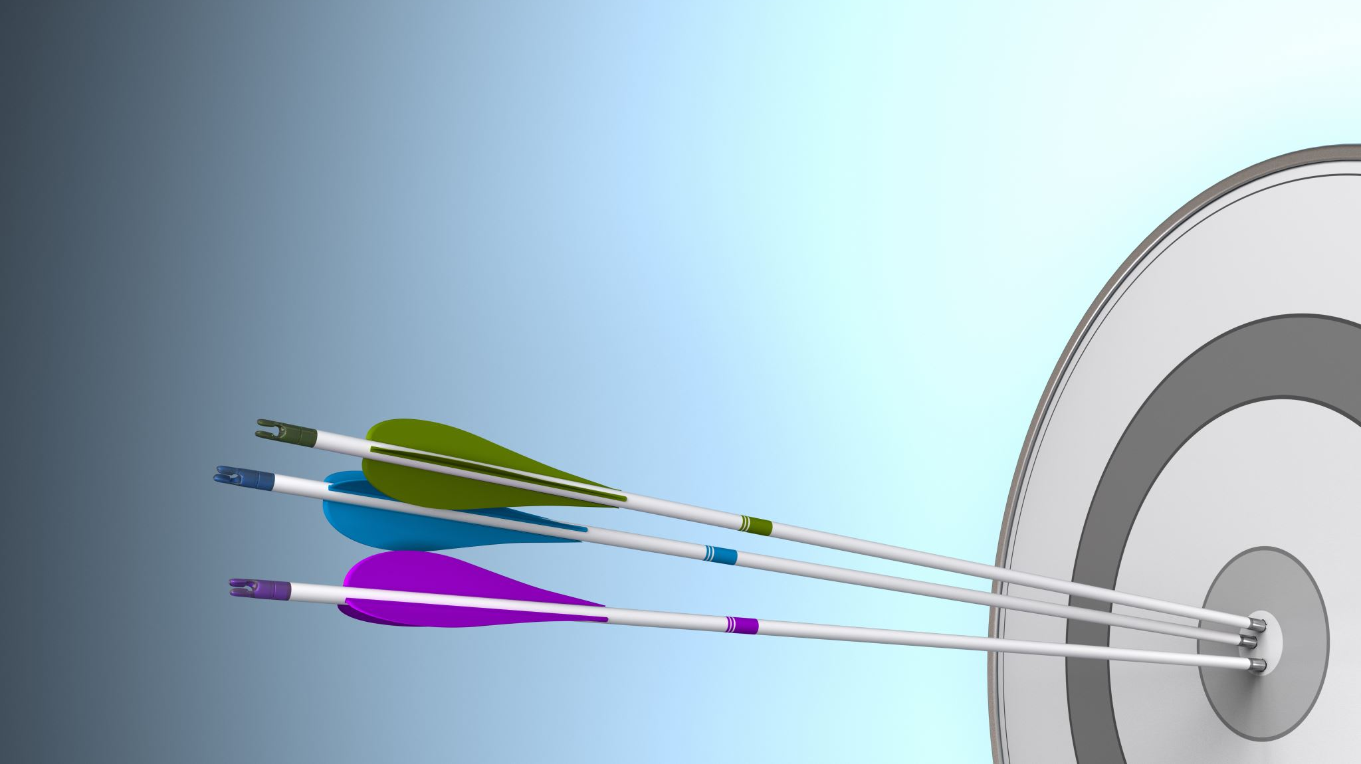
1.5. Target variable
Target variable, in the machine learning context, is the variable that is or should be the output. For example, it could be binary 0 or 1 if you are classifying or it could be a continuous variable if you are doing a regression. In statistics you also refer to it as the response variable.
In our study our target variable is HeartDisease in the context of determining whether anybody is likely to get hearth disease based on the input parameters like gender, age and various test results or not.

Slide 9
02. Exploratory data analysis & visualization
2.1 General Looking of Data
2.2 Examination of Target Variable
2.3 Examination of Numerical Features
2.4 Examination of Skewness and Kurtosis
2.5 Examination of Categorial Features
2.6 Dummy variables operation

Slide 10
2.1 General looking of data
There is 918 observation and 12 columns in the dataset
Number of Unique values for each attribute
Age has 50 unique values
Sex has 2 unique values
ChestPainType has 4 unique values
RestingBP has 67 unique values
Cholesterol has 222 unique values
FastingBS has 2 unique values
RestingECG has 3 unique values
MaxHR has 119 unique values
ExerciseAngina has 2 unique values
Oldpeak has 53 unique values
ST_Slope has 3 unique values
HeartDisease has 2 unique values

Slide 11
Checking missing number & missing percent for each attribute
 | Missing_Number | Missing_Percent
Age | 0 | 0.000
Sex | 0 | 0.000
ChestPainType | 0 | 0.000
RestingBP | 0 | 0.000
Cholesterol | 0 | 0.000
FastingBS | 0 | 0.000
RestingECG | 0 | 0.000
MaxHR | 0 | 0.000
ExerciseAngina | 0 | 0.000
Oldpeak | 0 | 0.000
ST_Slope | 0 | 0.000
ST_Slope | 0 | 0.000

Slide 12
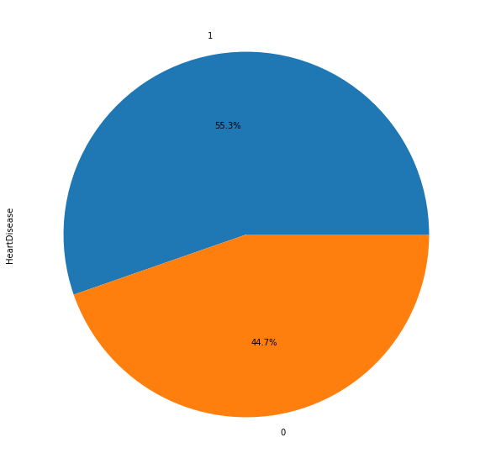
2.2. Examination of Target Variable
column name : HeartDisease per_of_nulls : % 0.0
num_of_nulls : 0
num_of_uniques : 2
1 508
0 410
Percentage of Heart Disease : 55.34%
(508 cases for Heart Disease)
Percentage of NOT Heart Disease : 44.66%
(410 cases for NOT Heart Disease)

Slide 13
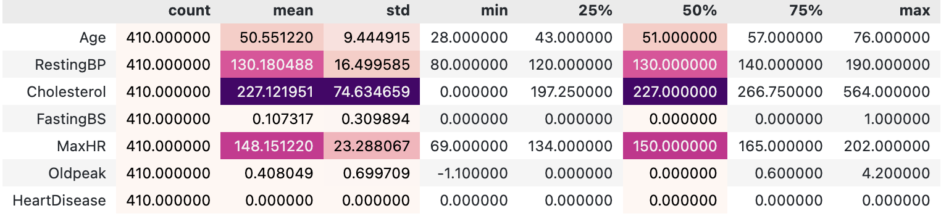
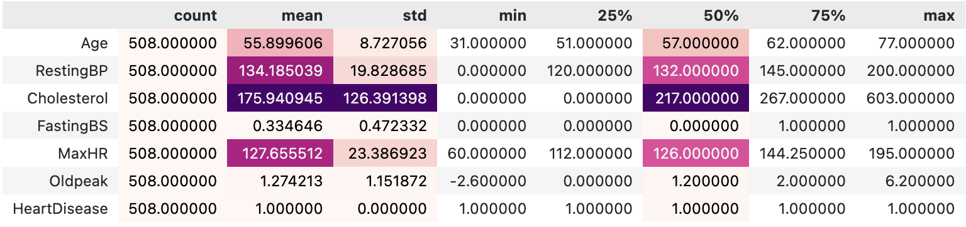
Measure of spread and center for not heart disease
Measure of speread and center for heart disease

Slide 14
Splitting Dataset into numeric & categoric features
Numerical variables
Age
RestingBP
Cholesterol
FastingBS
MaxHR
Oldpeak
Categorical variables
Sex
ChestPainType
RestingECG
ExerciseAngina
ST_Slope

Slide 15
2.3. Examination of Numerical Features

Slide 16
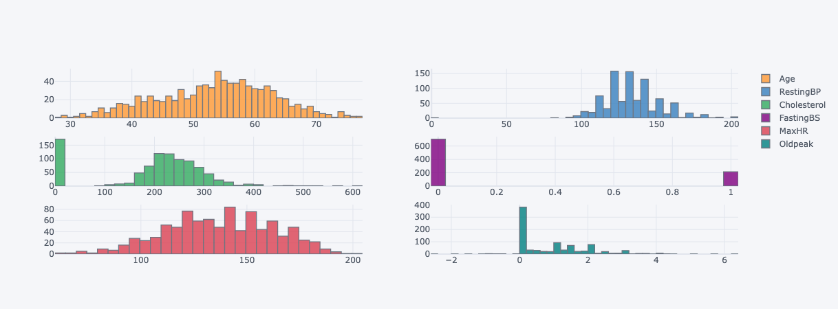
Data spared of Numerical variables

Slide 17
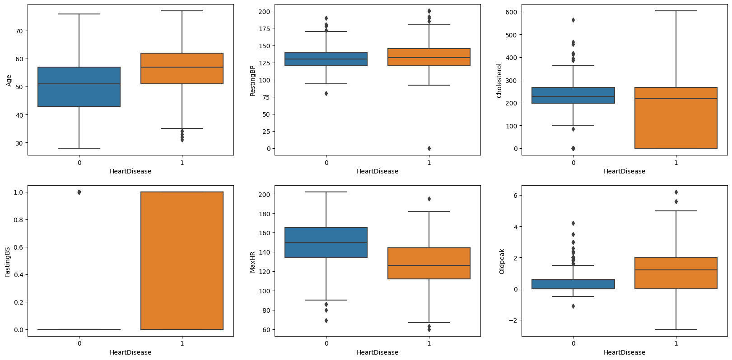
Spread of Numerical variables with having Diseases and not having Diseases

Slide 18
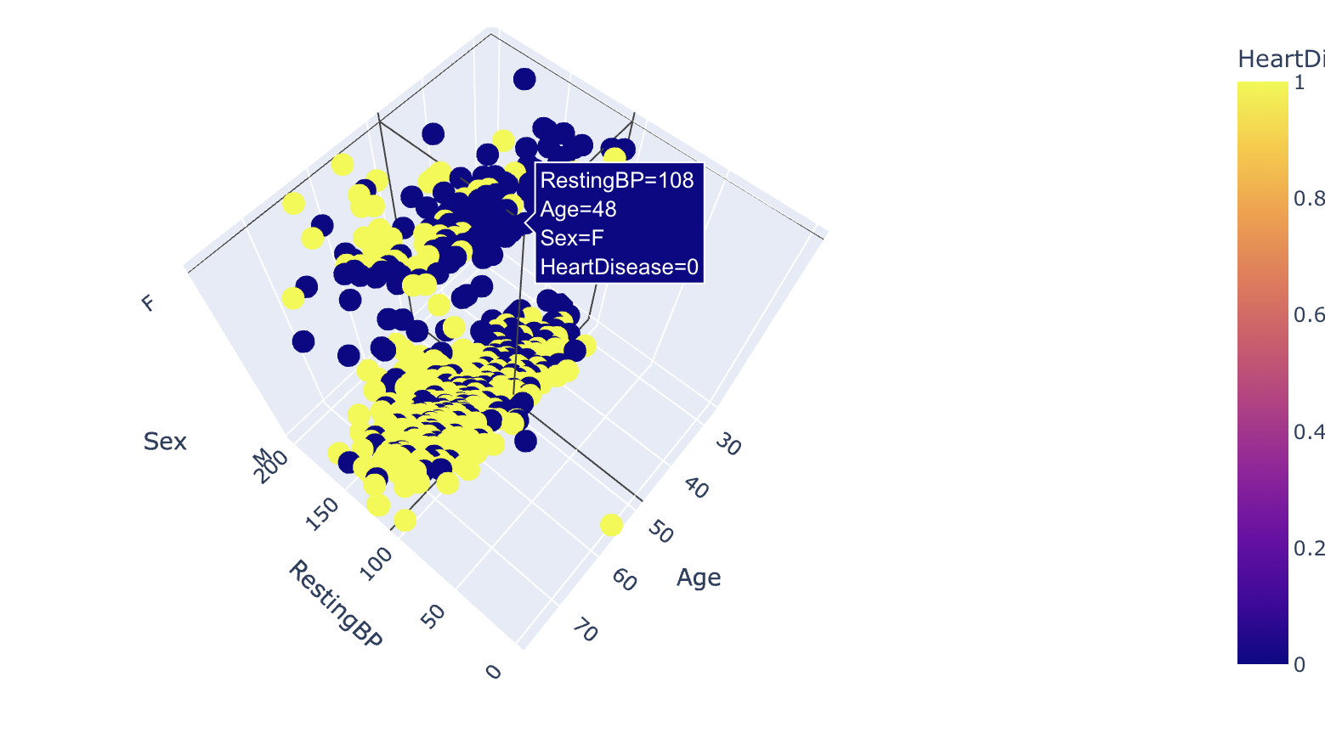
3D-Scatter Plot

Slide 19
2.4. The Examination of Skewness & Kurtosis
Note : 0.5 This is our threshold-limit to evaluate skewness
Skewness is used to measure the level of asymmetry in our data.
Measures of skewness help us to know to what degree and in which direction (positive or negative) the frequency distribution has a departure from symmetry
FastingBS | 1.264 | Means that the distribution is approx. highly skewed
Oldpeak | 1.023 | Means that the distribution is approx. highly skewed
RestingBP | 0.180 | Means that the distribution is approx. symmetric
MaxHR | -0.144 | Means that the distribution is approx. symmetric
Age | -0.196 | Means that the distribution is approx. symmetric
HeartDisease | -0.215 | Means that the distribution is approx. symmetric
Cholesterol | -0.610 | Means that the distribution is approx. highly skewed

Slide 20
The Examination of Skewness & Kurtosis
kurtosis measures the degree of peakness and flatness of a frequency distribution
Kurtosis are of three types:
Mesokurtic: When the tails of the distribution is similar to the normal distribution then it is mesokurtic. The kutosis for normal distribution is 3.
Leptokurtic: If the kurtosis is greater than 3 then it is leptokurtic. In this case, the tails will be heaviour than the normal distribution which means lots of outliers are present in the data. It can be recognized as thin bell-shaped distribution with peak higher than normal distribution.
Platykurtic: Kurtosis will be less than 3 which implies thinner tail or lack of outliers than normal distribution. In case of platykurtic, bell shaped distribution will be broader and peak will be lower than the mesokurtic.
RestingBP | 3.271
Oldpeak | 1.203
Cholesterol | 0.118
Age | -0.386
FastingBS | -0.402
MaxHR | -0.448
HeartDisease | -1.958
Note : 7 This is our threshold-limit to evaluate skewness. Overall below abs(1) seems acceptable for the linear models.

Slide 21
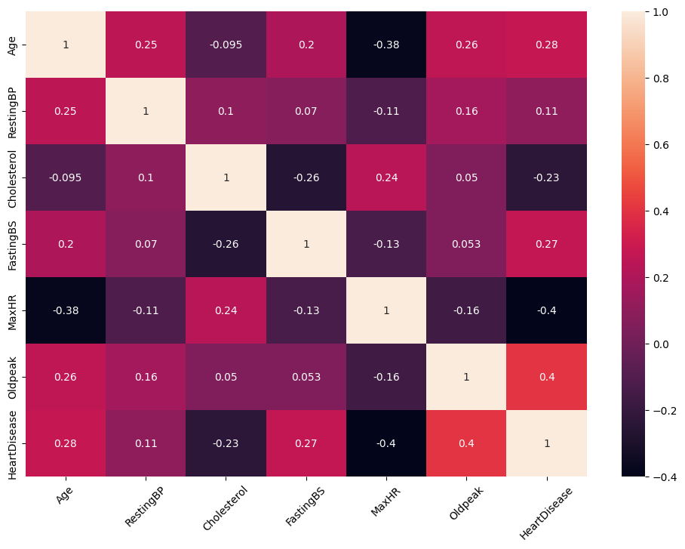
Examine the correlation among variables using heatmap.
Age with MaxHR negatively corelated with each other
MaxHR with HeartDiseases are Negatively correlated with each other
Cholestreol with FastingBS are Negatively correlated with each other,
and also, few of our variable positively correlation with Each other .

Slide 22
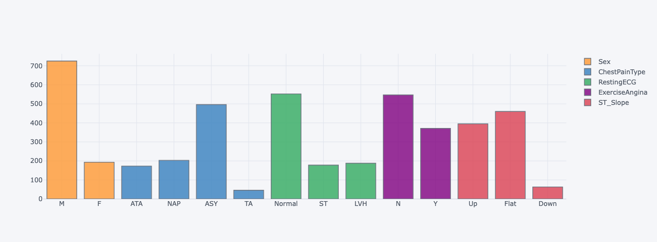
2.5. The Examination of Categorical Features

Slide 23
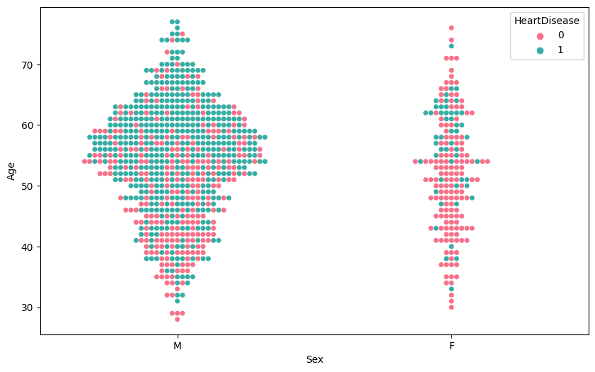
2.5 The Examination of Categorical variable with Heart Disease
M 725
F 193

Slide 24
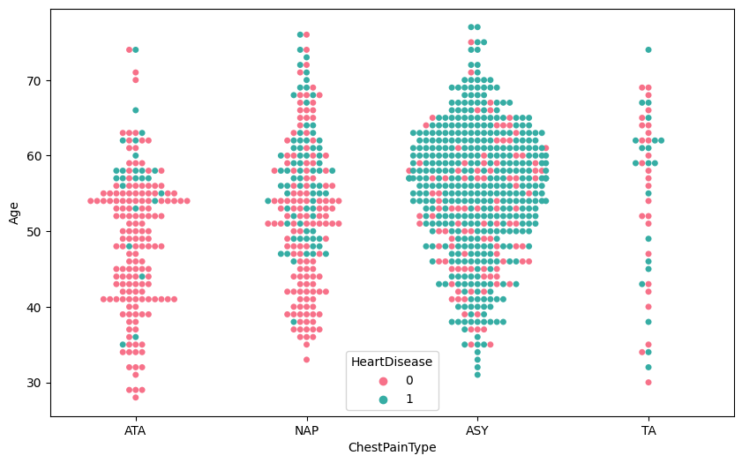
2.5 ChestPainType and HeartDisease
ASY : 496 NAP : 203 ATA : 173
TA : 46

Slide 25
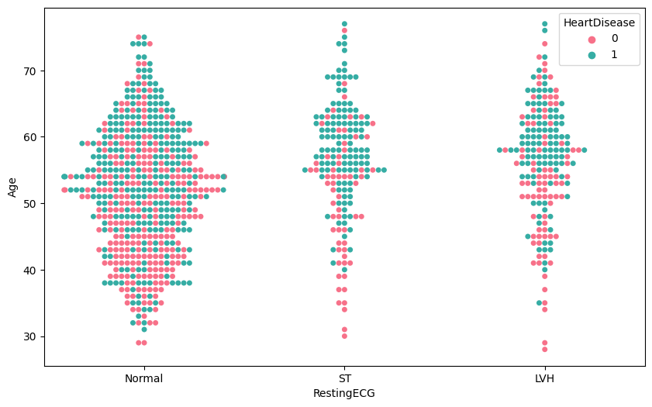
2.5. RestingECG and HeartDisease
Normal : 552
LVH : 188
ST : 178

Slide 26
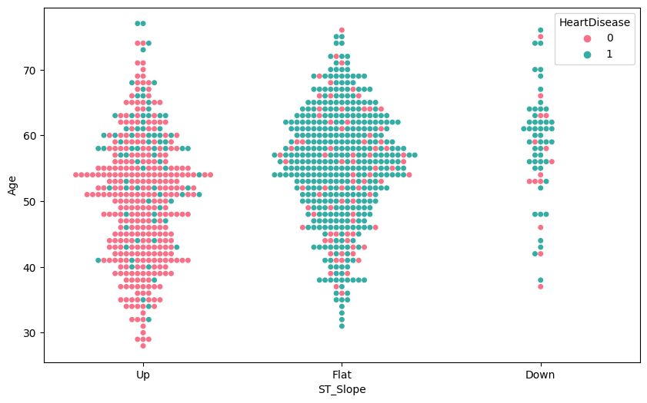
2.5. ST_Slope and HeartDisease
Flat : 460
Up : 395
Down : 63

Slide 27
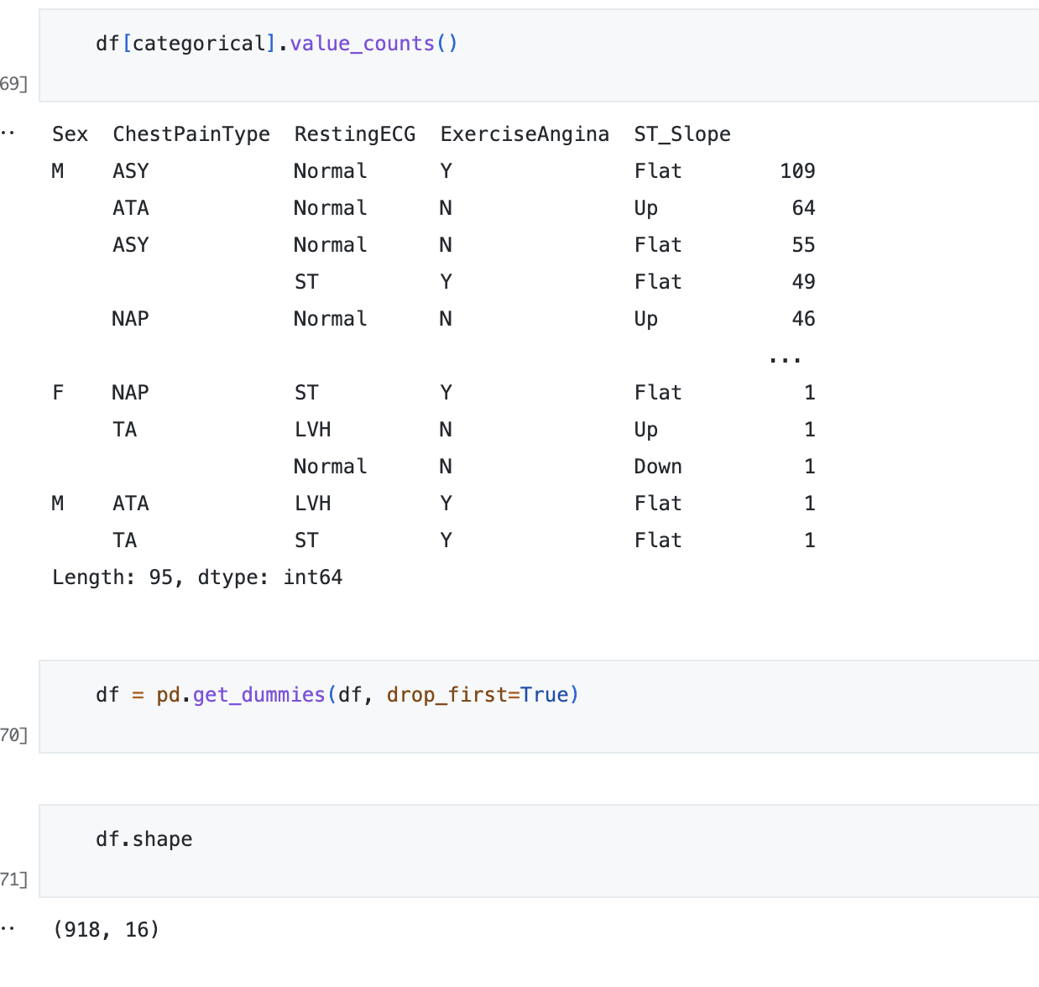
2.6. Dummy Variables Operation
A dummy variable is a variable that takes values of 0 and 1, where the values indicate the presence or absence of something (e.g., a 0 may indicate a placebo and 1 may indicate a drug). Where a categorical variable has more than two categories, it can be represented by a set of dummy variables, with one variable for each category. Numeric variables can also be dummy coded to explore nonlinear effects. Dummy variables are also known as indicator variables, design variables, contrasts, one-hot coding, and binary basis variables.

Slide 28

03. TRAIN | TEST SPLIT &
HANDLING WITH MISSING VALUES
3.1. Train | Test Split
3.2. Handling with Missing Values

Slide 29
3.1. Train | Test Split
Train test split is a common technique used in machine learning to evaluate the performance of a model on unseen data. In this technique, a dataset is split into two parts: a training set and a testing set.
The training set is used to train the model, while the testing set is used to evaluate its performance. The idea is that if a model performs well on the testing set, it is likely to perform well on new, unseen data as well.
Typically, a random portion of the data, say 70-80%, is used for training, while the remaining 20-30% is used for testing. The data is usually shuffled before the split to avoid any bias in the splitting process.
After the model is trained on the training set, it is evaluated on the testing set to measure its performance. The testing set should be representative of the kind of data that the model is expected to encounter in real-world scenarios.
The train test split technique helps to prevent overfitting, which is a common problem in machine learning. Overfitting occurs when a model is too complex and captures the noise in the training data, rather than the underlying patterns. By evaluating the model on an independent testing set, it is possible to detect overfitting and adjust the model accordingly.

Slide 30
We must separate the columns (attributes or features) of the dataset into input patterns (X) and output patterns (y).
X = df.drop(["HeartDisease"], axis=1)
y = df["HeartDisease"]
Finally, we can split the X and Y data into a training and test dataset. The training set will be used to prepare the models used in this study and the test set will be used to make new predictions, from which we can evaluate the performance of the model.
For this we will use the train_test_split() function from the scikit-learn library. We also specify a seed for the random number generator so that we always get the same split of data each time this example is executed.
Train / Test and Split
X_train, X_test, y_train, y_test = train_test_split(X, y, test_size=0.15,
stratify = y, random_state = 101)

Slide 31
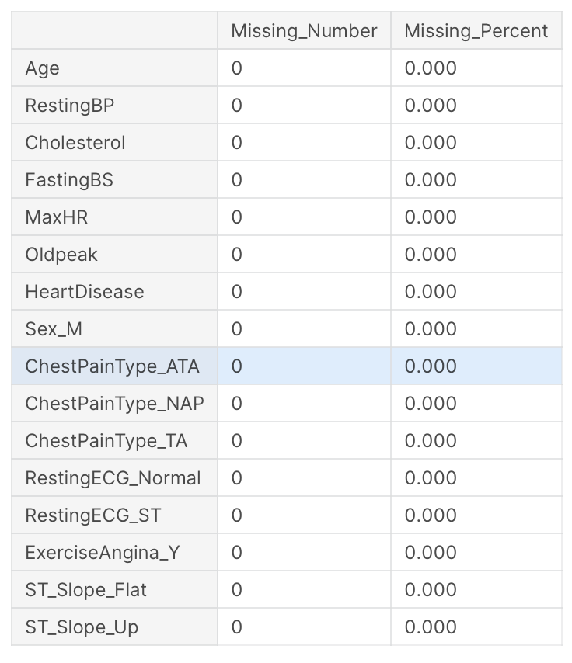
3.2. Handling with Missing Values
missing(df)
In our dataset, there have been no missing values so there is no need to handle with them.

Slide 32


04. FEATURE SCALING
4.1. The Implementation of Scaling
4.2. General Insights Before Going Further
4.3. Handling with Skewness with PowerTransform & Checking Model Accuracy Scores.

Slide 33
4.1. The Implementation of Scaling
Feature scaling (Normalization) is a method used to normalize the range of independent variables or features of data. In data processing, it is also known as data normalization and is generally performed during the data pre-processing step.
For machine learning, in general, it is necessary to normalize features so that no features are arbitrarily large (cantering) and all features are on the same scale (scaling).
In general, algorithms that exploit distances or similarities (e.g., in the form of scalar product) between data samples, such as K-NN and SVM, are sensitive to feature transformations. So, it is generally useful, when you are solving a system of equations, least squares, etc, where you can have serious issues due to rounding errors.
However, Graphical-model based classifiers, such as Fisher LDA or Naive Bayes, as well as Decision trees and Tree-based ensemble methods (RF, XGB) are invariant to feature scaling, but still, it might be a good idea to rescale/standardize your data.

Slide 34
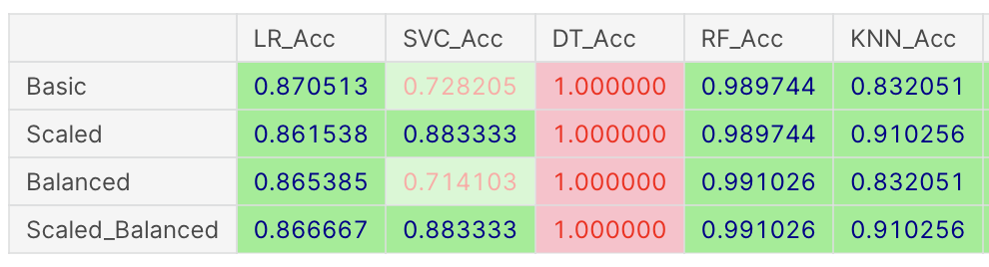
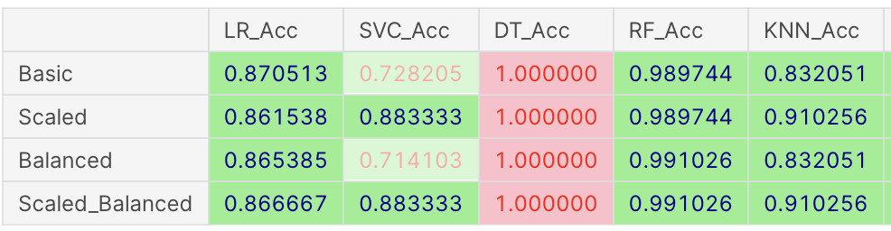
4.2. General Insights Before Going Further

Slide 35
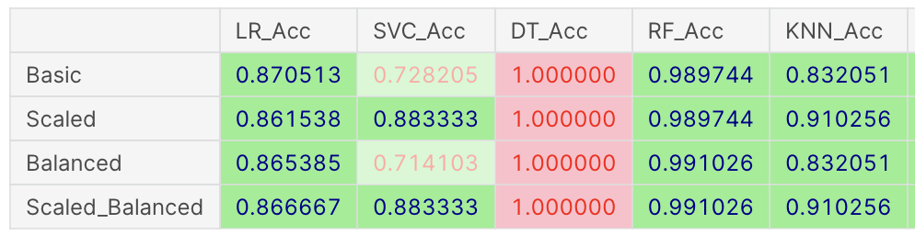
4.3. Handling with Skewness with PowerTransform & Checking Model Accuracy Scores
Accuracy Scores
NOTE: When we examine the results after handling with skewness, it's clear to assume that handling with skewness could NOT make any contribution to our model when comparing the results obtained by LogisticClassifier without using PowerTransform. So, for the next steps in this study, we will continue not handling with skewness assuming that it's useless for the results.

Slide 36
Pipeline Object
A pipeline object is a tool in scikit-learn that allows for chaining multiple steps into a single object. It is particularly useful for creating a consistent and repeatable process for data preparation and modelling.
In the case of a logistic regression classifier, the pipeline object can be used to standardize the data and apply the logistic regression algorithm in a single step.
The pipeline object can be fit to the data and used for predictions in the same way as a regular logistic regression model.
By using a pipeline object, you can ensure that the same pre-processing steps are applied consistently to the training and test data, and that the entire process is encapsulated in a single object for easy use and reuse.

Slide 37
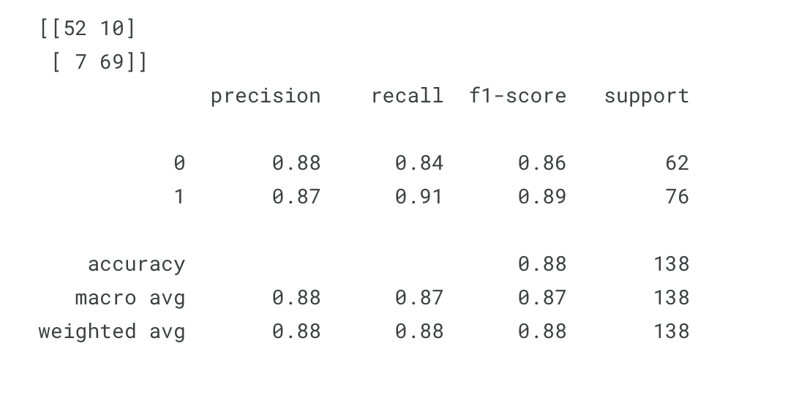
Confusion matrix and Classification report for y_test, y_pred

Slide 38
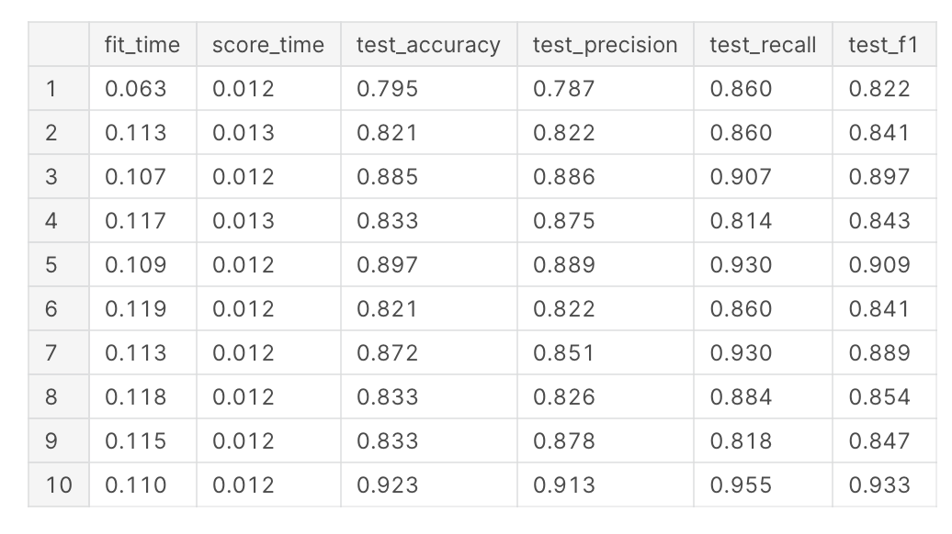
Cross Validation for Pipeline

Slide 39
Evaluating the pipeline
Accuracy:
Results Mean : %85.75
Results Standard Deviation : 3.228
We are now ready to train our models.
After determining related Classifiers from the scikit-learn framework, we can create and fit them to our training dataset. Models are fit using the scikit-learn API and the model.fit() function.
Then we can make predictions using the fit model on the test dataset. To make predictions we use the scikit-learn function model.predict().

Slide 40
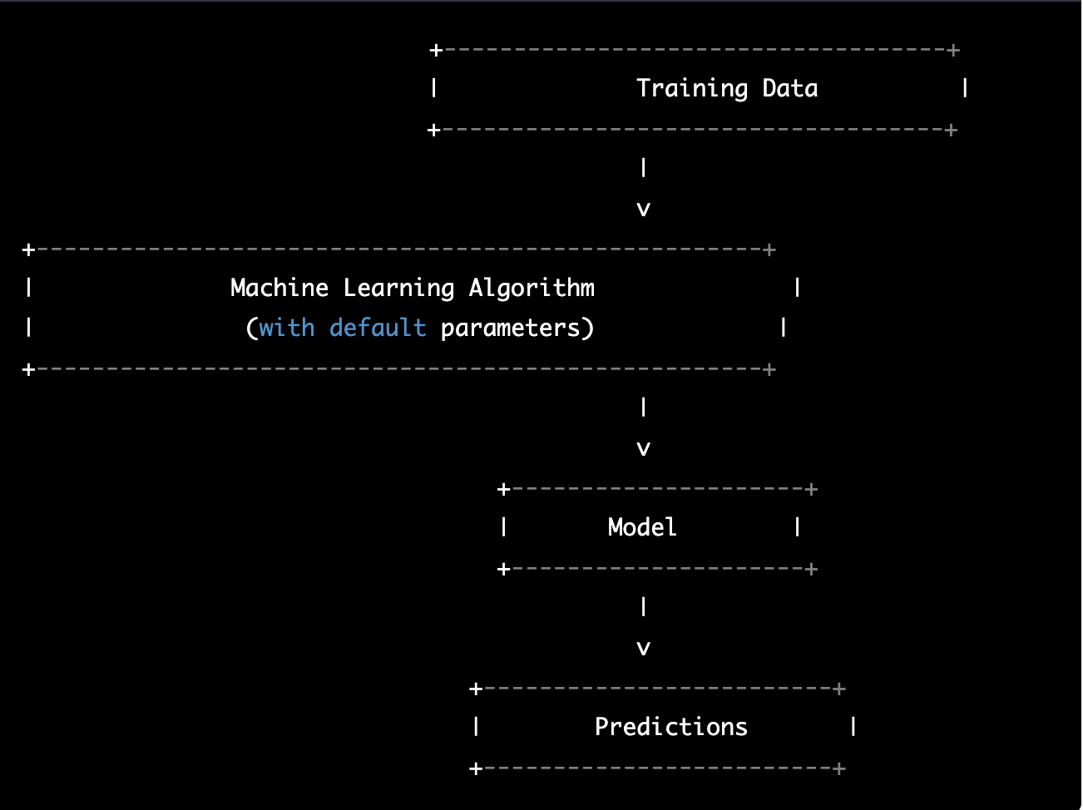
Modelling With Default Parameters
The machine learning algorithm is used with its default parameters to train a model on a given dataset. The resulting model is then used to make predictions on new data.
Note that the parameters of the machine learning algorithm are not adjusted or customized in any way, and the algorithm is used in its default state. This can be a fast and convenient way to create a baseline model, but it may not always produce the best results. In some cases, it may be necessary to adjust the parameters of the algorithm to improve the model's performance on a particular task.

Slide 41
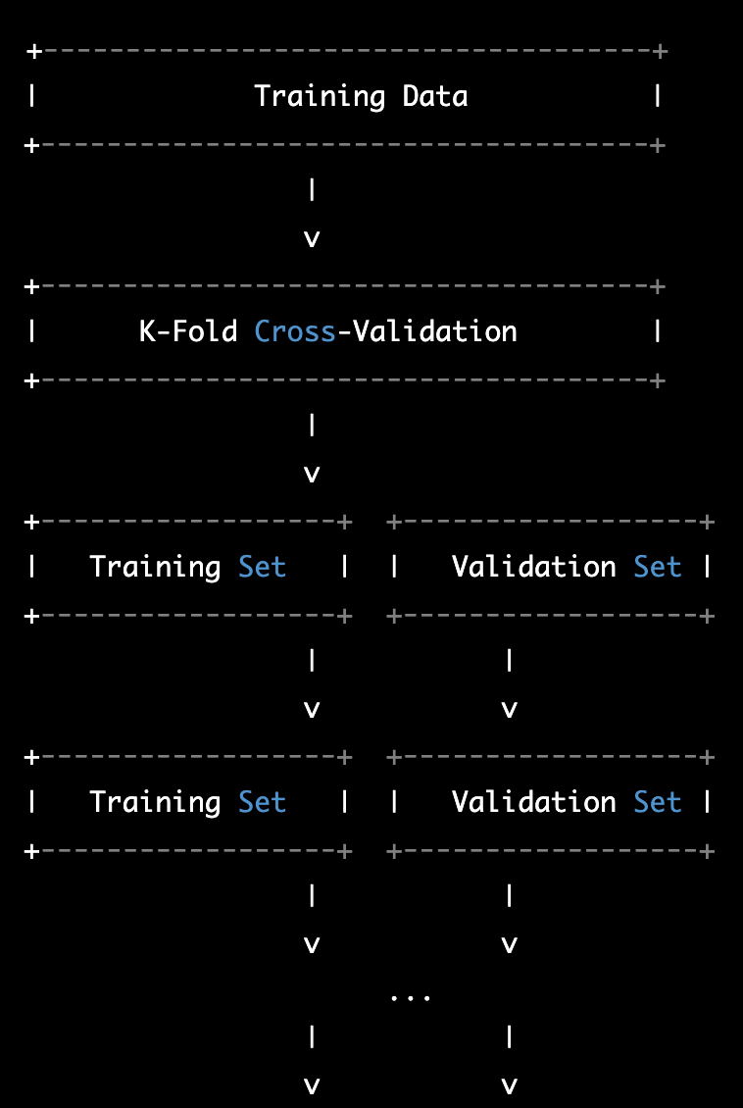
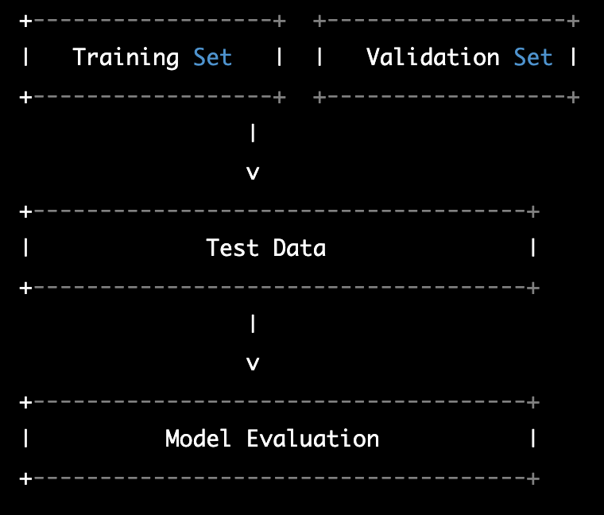
Cross Validation
The training data is split into K subsets, or "folds", using K-fold cross-validation. The algorithm is trained on K-1 of the folds and validated on the remaining fold. This process is repeated K times, with each fold being used as the validation set once.
Once the model is trained and validated using cross-validation, it is evaluated on a separate test set that was not used in the training process. The evaluation results provide an estimate of how the model is likely to perform on new, unseen data.
Note that in each iteration of K-fold cross-validation, the training set and validation set are different, and the algorithm is trained on a slightly different subset of the data. This helps to reduce overfitting and provide a more reliable estimate of the model's performance on new data.

Slide 42
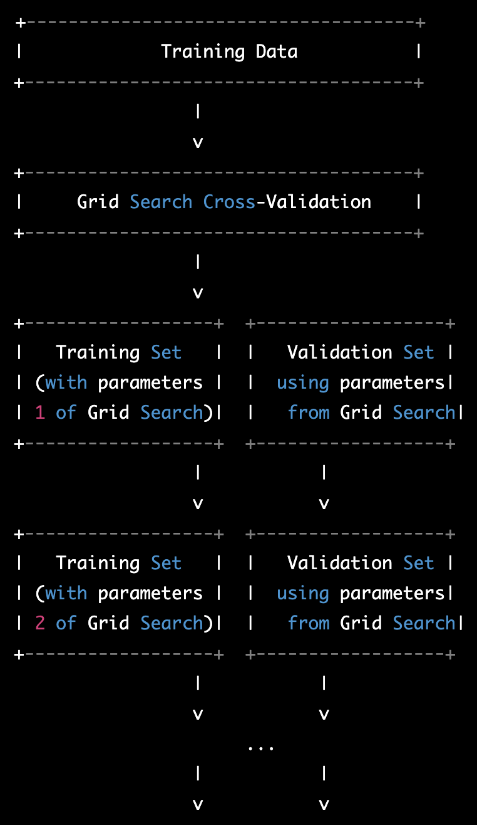
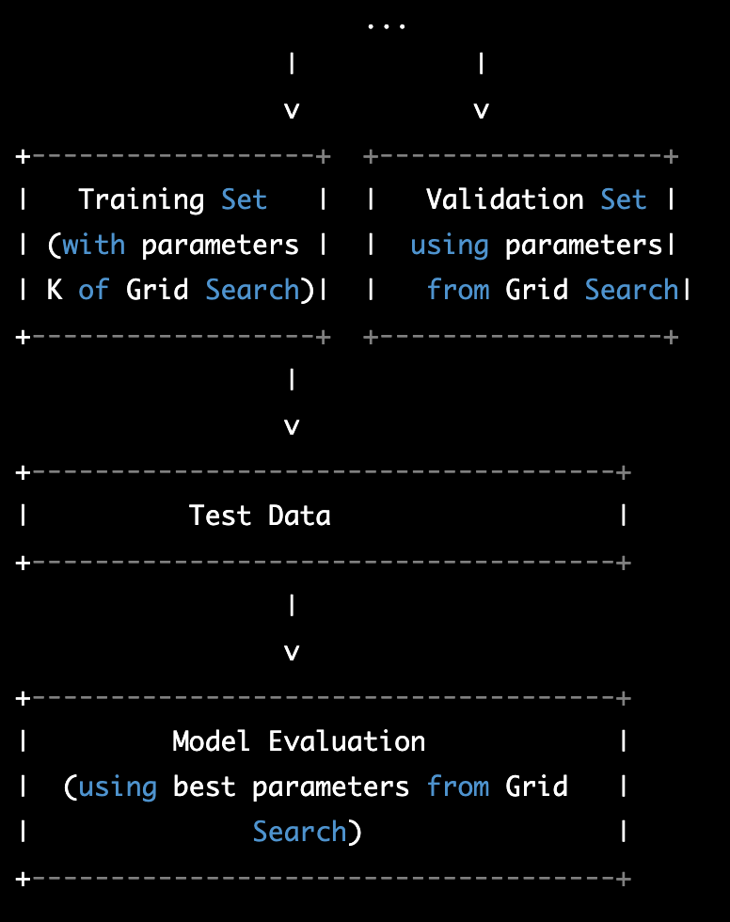
Modelling with Best Parameters Using GridSeachCV
the training data is first split into training and validation sets. Then, a grid search is performed to identify the best combination of hyperparameters for the machine learning algorithm. The grid search involves training and evaluating the model on multiple combinations of hyperparameters.
Once the best hyperparameters are identified, the algorithm is trained on the entire training set using the best parameters. The resulting model is then evaluated on a separate test set that was not used in the training process, using the best hyperparameters identified during the grid search.
Note that in each iteration of the grid search, the algorithm is trained and validated on a slightly different subset of the data, using different combinations of hyperparameters. This helps to identify the best hyperparameters that generalize well to new, unseen data.

Slide 43
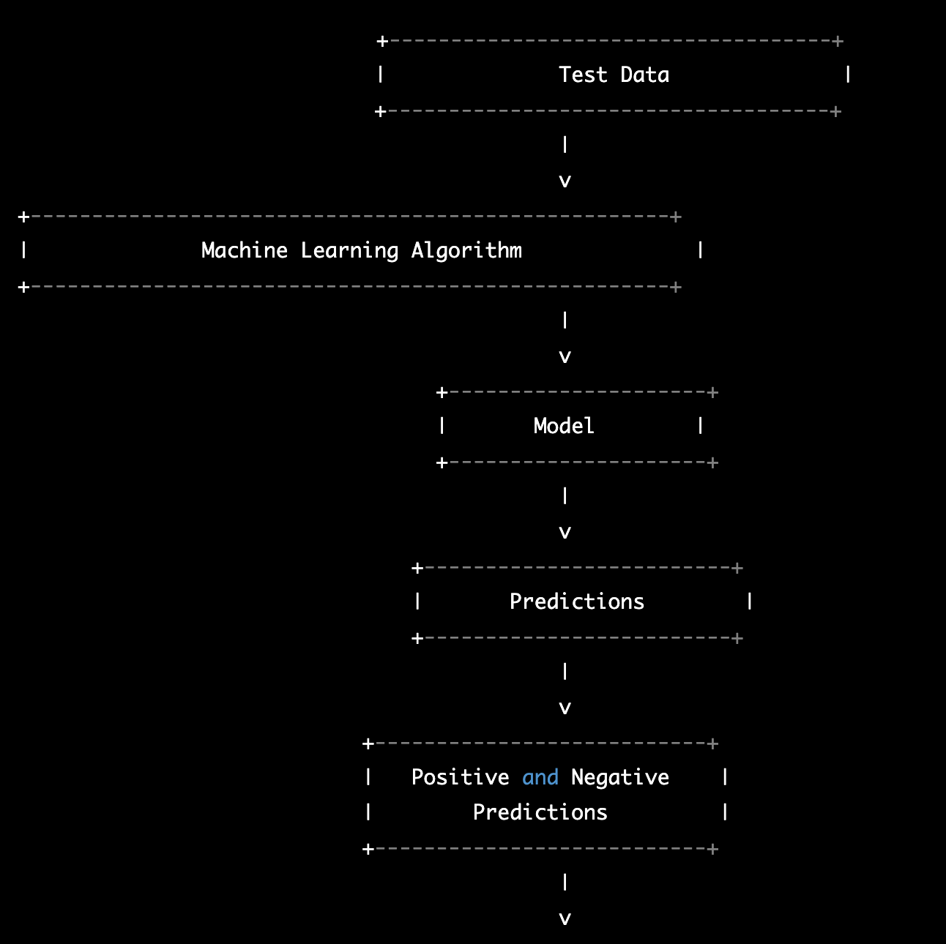
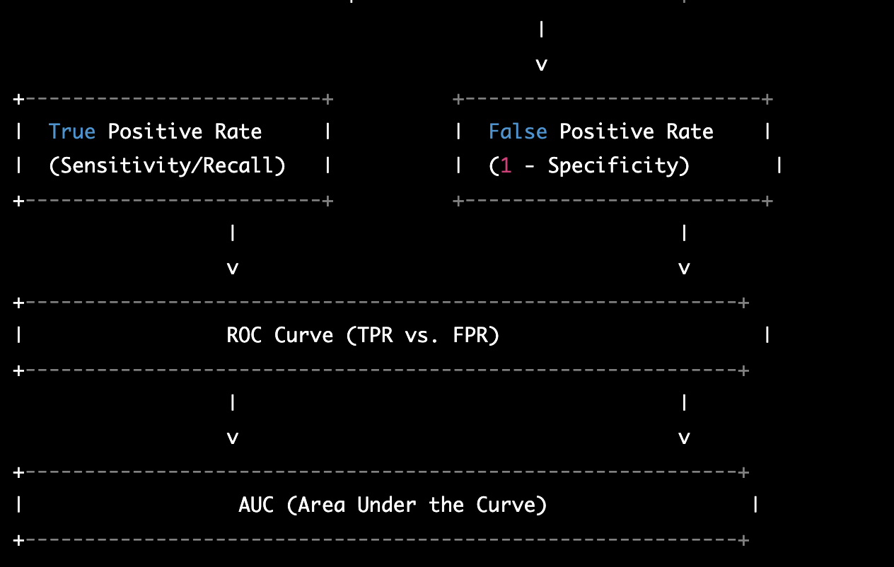
ROC (Receiver Operating Curve) and AUC (Area Under Curve)
The machine learning algorithm is trained on a training set and evaluated on a separate test set. The resulting model is then used to make predictions on the test set, and these predictions are compared to the actual values to compute the true positive rate (TPR) and false positive rate (FPR).
The TPR represents the proportion of positive instances that are correctly classified as positive by the model, while the FPR represents the proportion of negative instances that are incorrectly classified as positive by the model. By varying the threshold for classification, different TPR and FPR values can be obtained, which can be plotted on an ROC curve.
The ROC curve shows the trade-off between TPR and FPR at different classification thresholds. A model with high sensitivity (TPR) and low false positive rate (FPR) will have a curve that is closer to the top left corner of the plot. The AUC represents the area under the ROC curve, which provides a single metric for comparing different models. A model with an AUC of 1.0 is a perfect classifier, while a model with an AUC of 0.5 is no better than random guessing.

Slide 44
The Determination of The Optimal Threshold
The optimal threshold in binary classification is the probability threshold that maximizes a chosen performance metric, such as accuracy, precision, recall, F1-score, or ROC AUC.
It's important to note that the optimal threshold may differ depending on the problem and the specific performance metric that you choose to optimize for. Therefore, it's important to carefully consider the performance metric that is most appropriate for your problem and to evaluate the model's performance on a holdout dataset.

Slide 45

05. MODELLING & MODEL PERFORMANCE
5.1 The Implementation of Models
5.2 Cross-Validating Logistic
5.3 Modelling with Best Parameters Using GridSeachCV 5.4 ROC (Receiver Operating Curve) and AUC (Area Under Curve)
5.5 The Determination of The Optimal Threshold

Slide 46
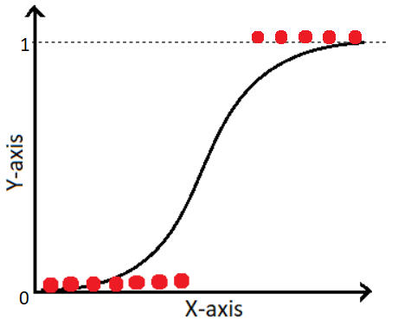
01. Logistic Regression
Logistic regression is a popular classification algorithm used to model the probability of a binary or multi-class target variable given a set of input features. It is a statistical method that belongs to the family of generalized linear models.
In logistic regression, the output variable (i.e., the class label) is modelled as a function of one or more input features, using a logistic or sigmoid function. The output of the logistic function is a probability value between 0 and 1, which can be interpreted as the likelihood of a sample belonging to a particular class. The logistic function ensures that the output probability values are always between 0 and 1, which makes it suitable for binary classification problems.
The logistic regression model is trained on a labelled dataset, where each sample is associated with a binary or multi-class label. The model is then used to predict the class labels of new, unseen samples based on their input features.

Slide 47
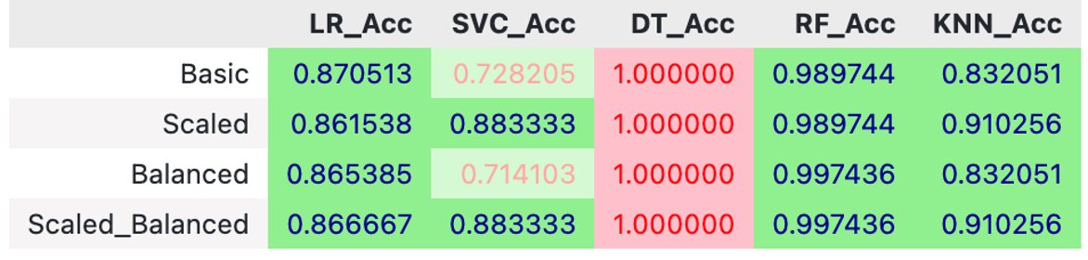
The Implementation of Models
First let's take a close look at the models' accuracy scores for comparing the results given by Scaled, Not Scaled, Balanced and Not Balanced models.

Slide 48
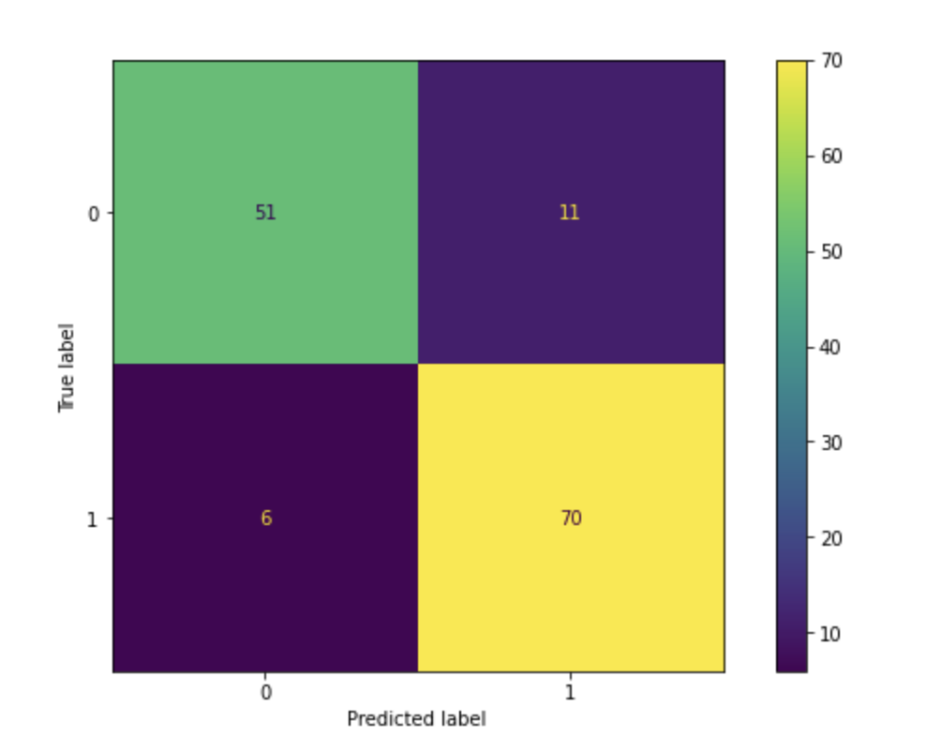
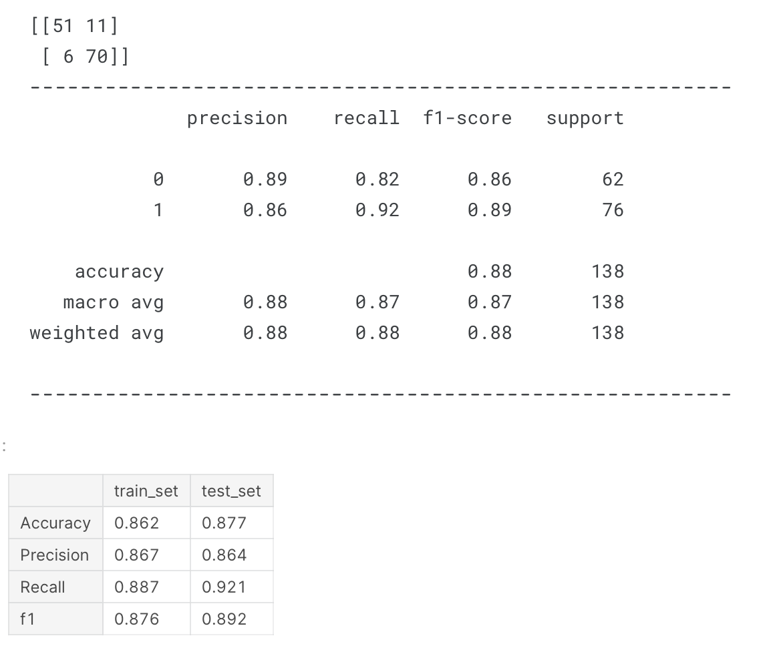
Modelling Logistic Regression (LR) with Default Parameters
Since Basic accuracy outcome gives the best model accuracy results, we will implement it

Slide 49
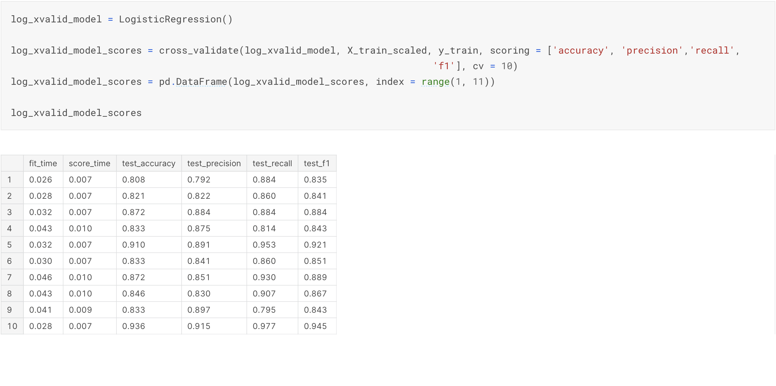
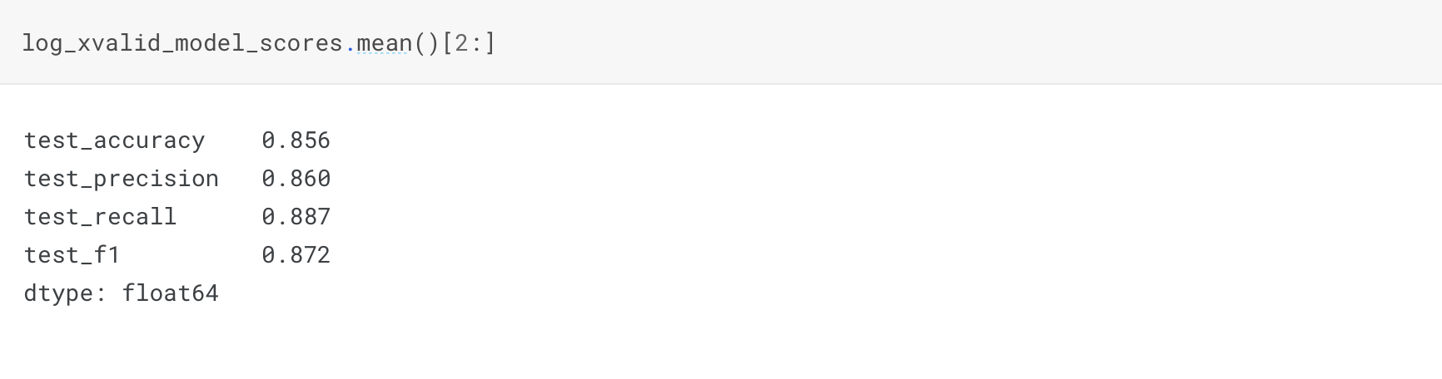
Cross-Validating Logistic Regression (LR) Model

Slide 50

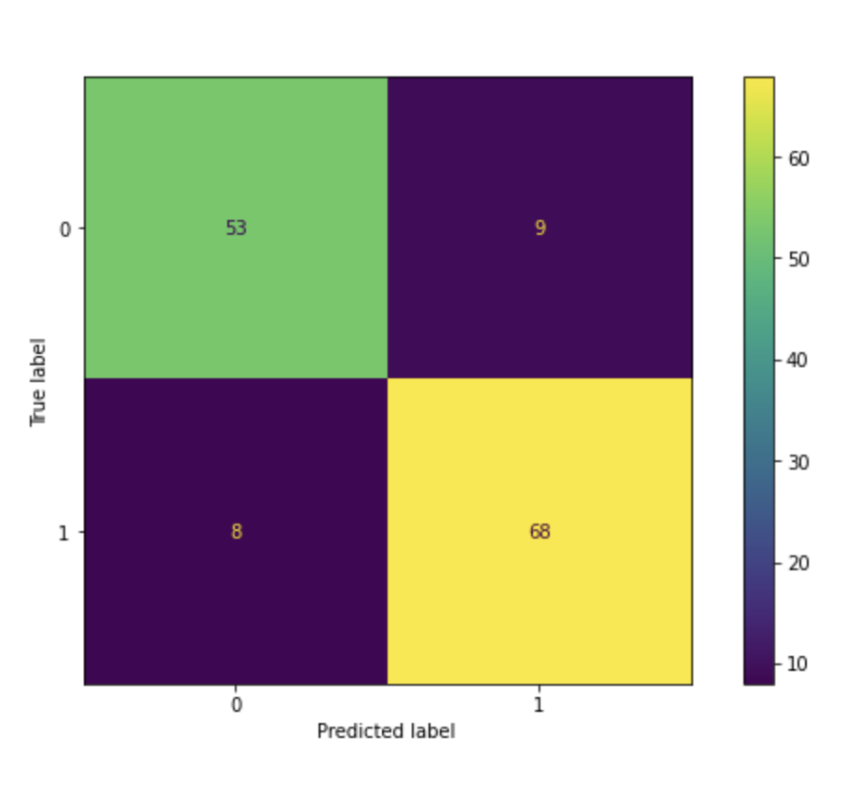
Modelling Logistic Regression (LR) with Best Parameters Using GridSeachCV
Let's look at the best parameters & estimator found by GridSearchCV.

Slide 51
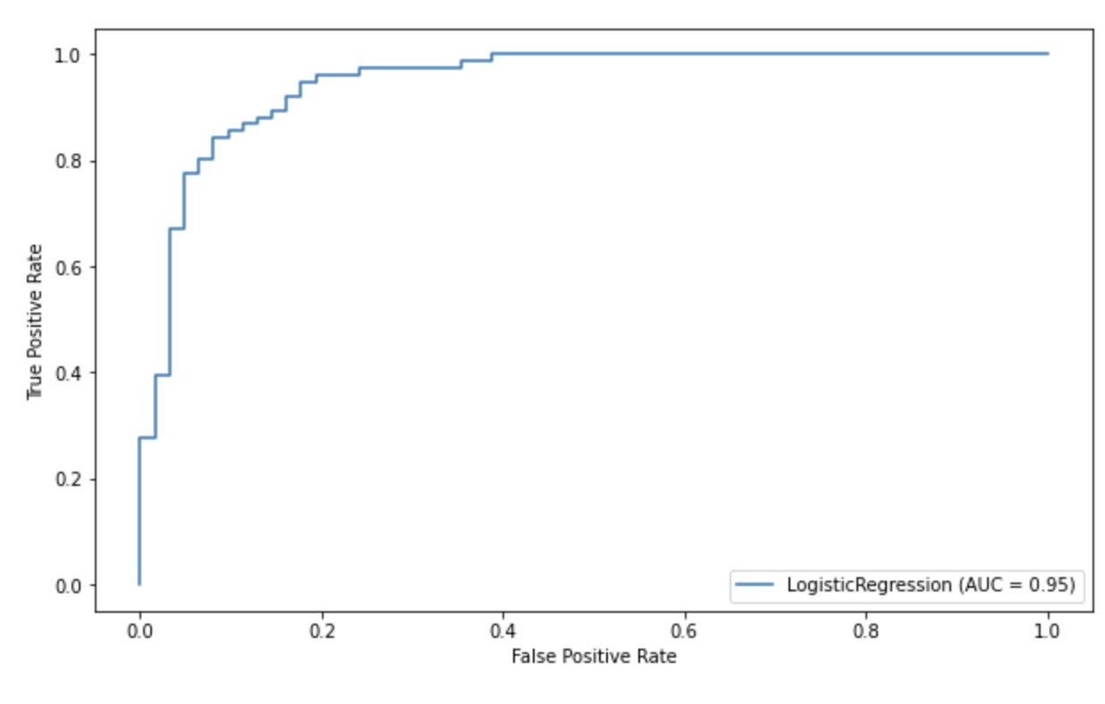
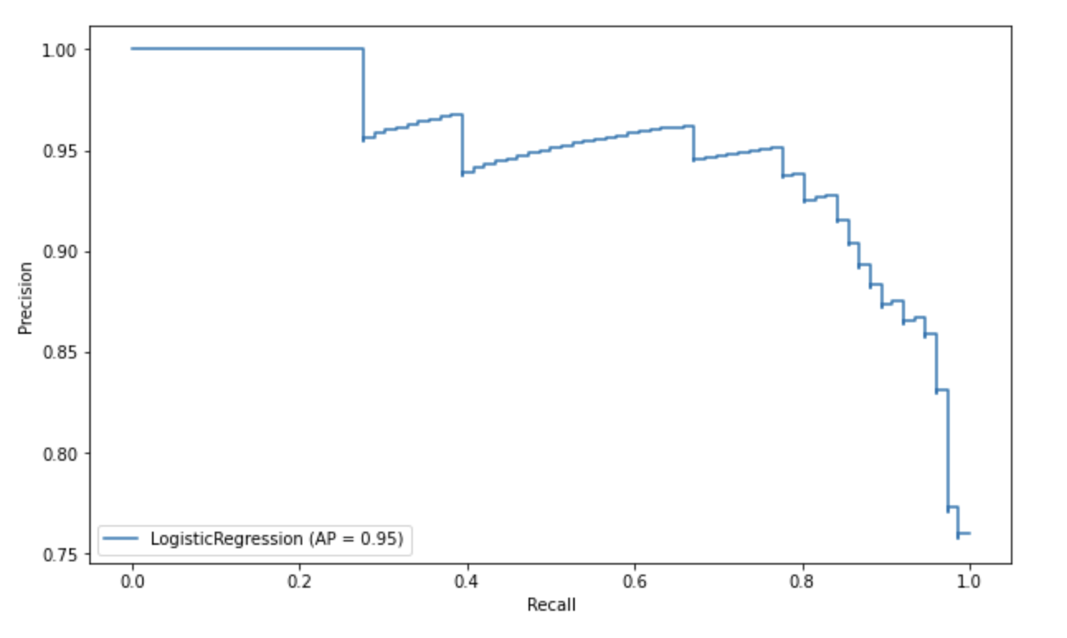
ROC (Receiver Operating Curve) and AUC (Area Under Curve)

Slide 52
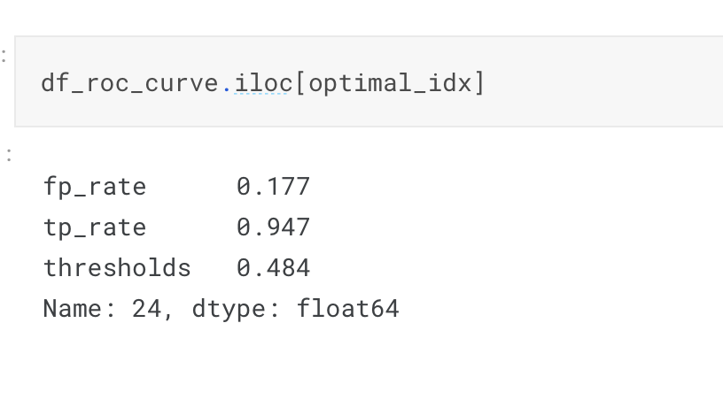
The Determination of The Optimal Threshold

Slide 53
02. Support Vector Machine (SVM)
Support Vector Machine (SVM) is a popular machine learning algorithm that can be used for classification tasks. Here's a general overview of how to use SVM for classification:
Gather and pre-process data: Collect a labelled dataset and pre-process the data to ensure that it is clean and ready for use in training an SVM model.
Split the dataset: Split the dataset into a training set and a testing set. The training set will be used to train the SVM model, and the testing set will be used to evaluate the performance of the model.
Choose the kernel: The kernel function is a key component of SVM, as it is used to transform the input data into a higher-dimensional space where the classes are separable by a hyperplane. There are different types of kernel functions, such as linear, polynomial, and radial basis function (RBF) kernels. The choice of kernel function depends on the problem at hand and the characteristics of the data.
Train the SVM model: Train the SVM model on the training set by finding the hyperplane that maximizes the margin between the classes. This is done by solving an optimization problem, where the goal is to find the parameters that minimize the classification error and maximize the margin.
Evaluate the performance: Evaluate the performance of the SVM model on the testing set by computing metrics such as accuracy, precision, recall, and F1-score. These metrics provide a measure of how well the model is able to classify the testing data.
Tune the hyperparameters: Fine-tune the hyperparameters of the SVM model, such as the regularization parameter, the kernel coefficient, and the kernel type, to improve the performance of the model.
Make predictions: Once the SVM model is trained and tuned, it can be used to make predictions on new, unseen data by applying the learned hyperplane to the input features.

Slide 54
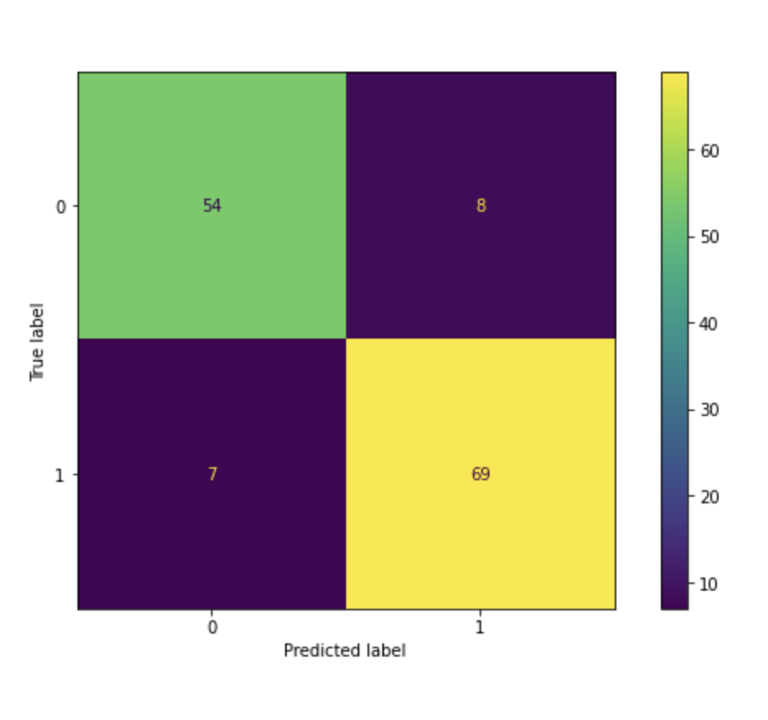
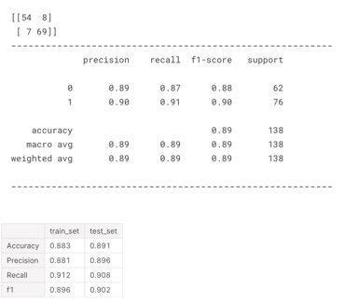
Modelling Support Vector Machine (SVM) with Default Parameters

Slide 55
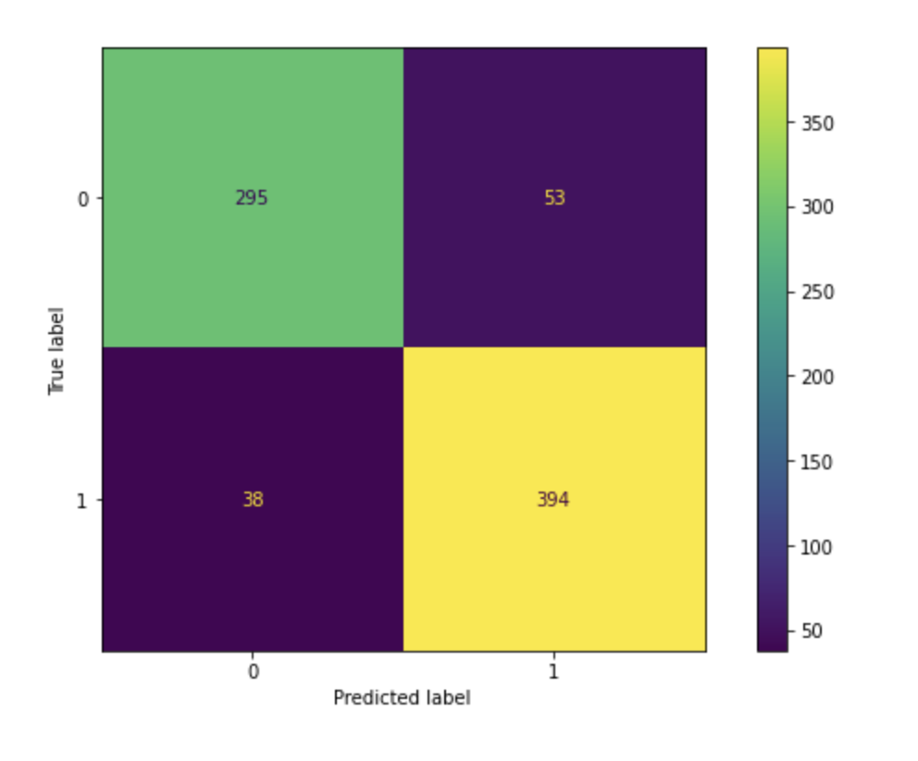
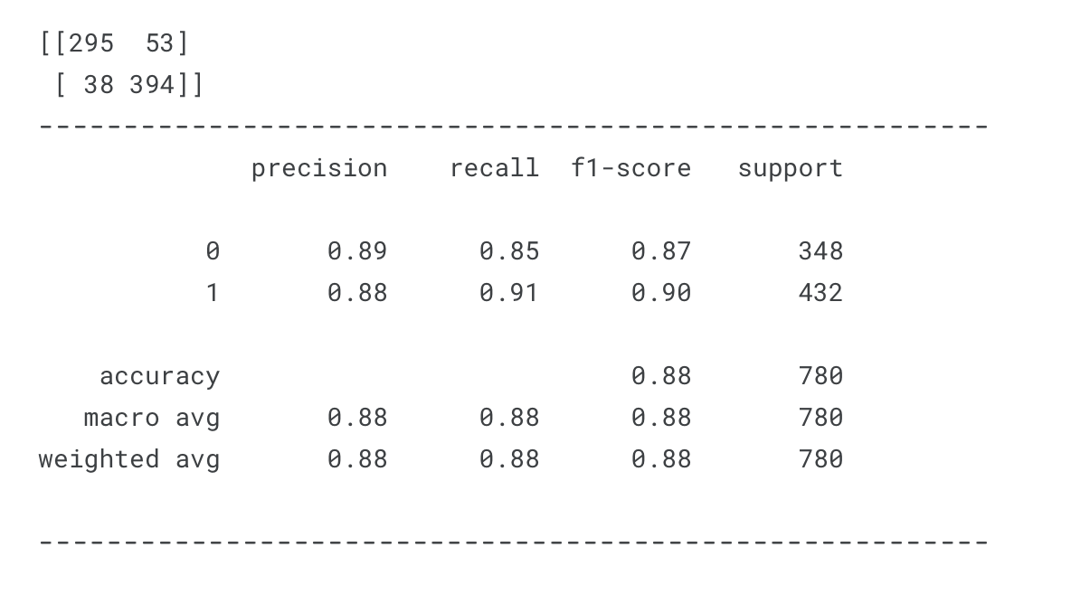
Cross-checking the model by predictions in Train Set for consistency

Slide 56
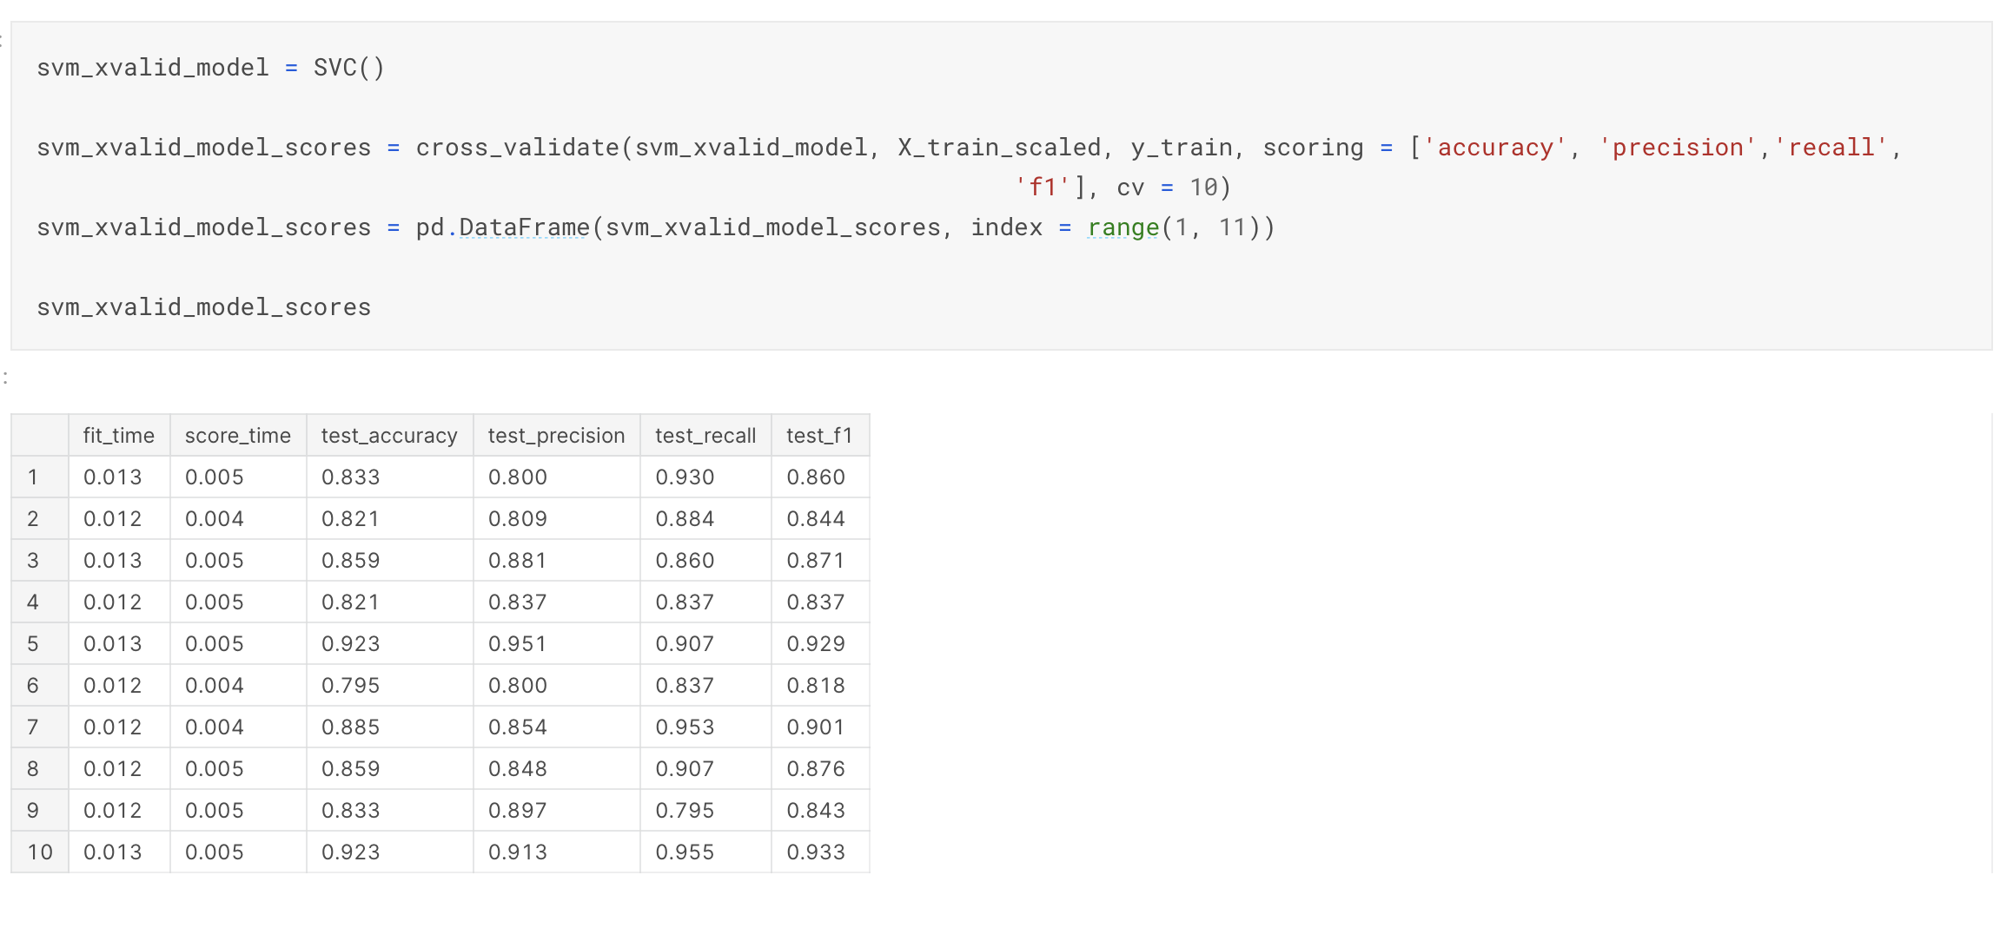
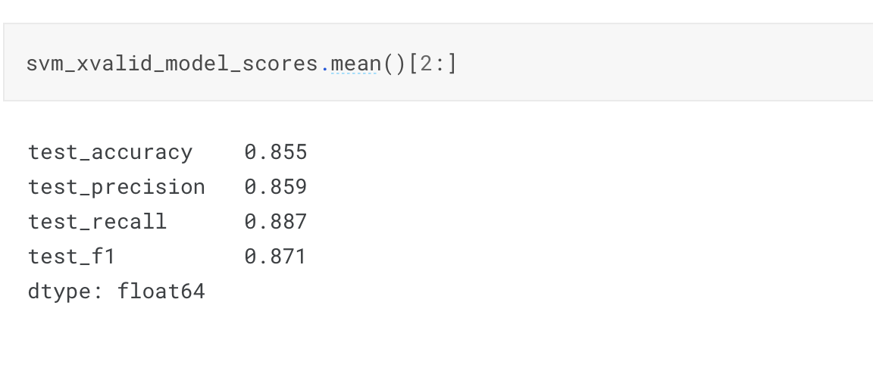
Cross-Validating Support Vector Machine (SVM) Model

Slide 57
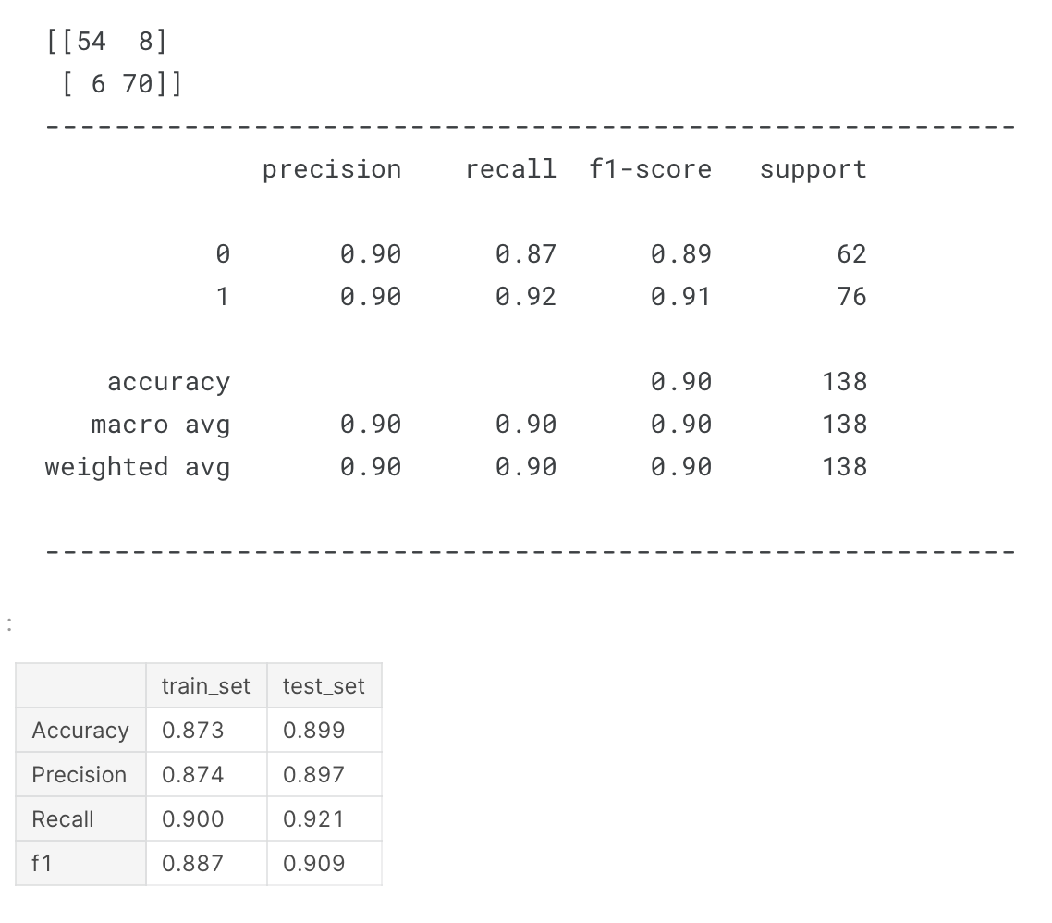
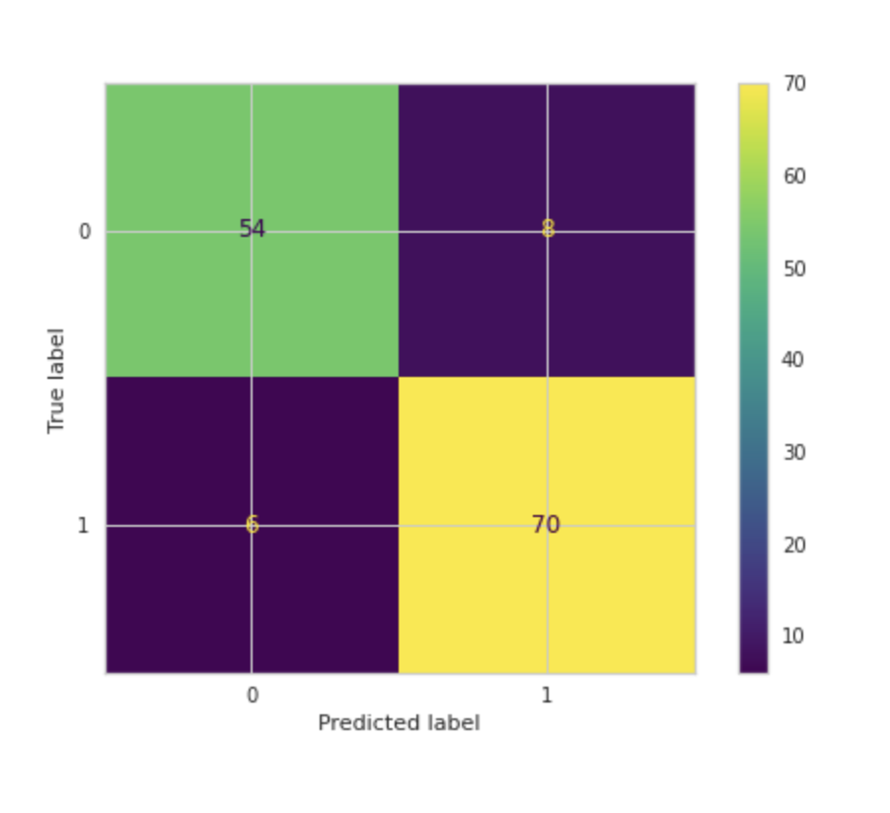
Modelling Support Vector Machine (SVM) with Best Parameters Using GridSeachCV
GridSearchCV made a little contribution to True Positive predictions by increasing 69 to 70 while True Negative predictions stayed same.

Slide 58
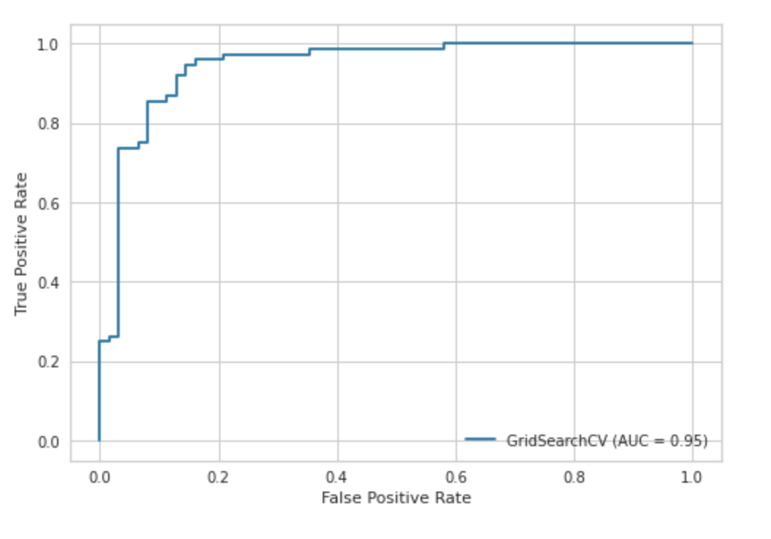
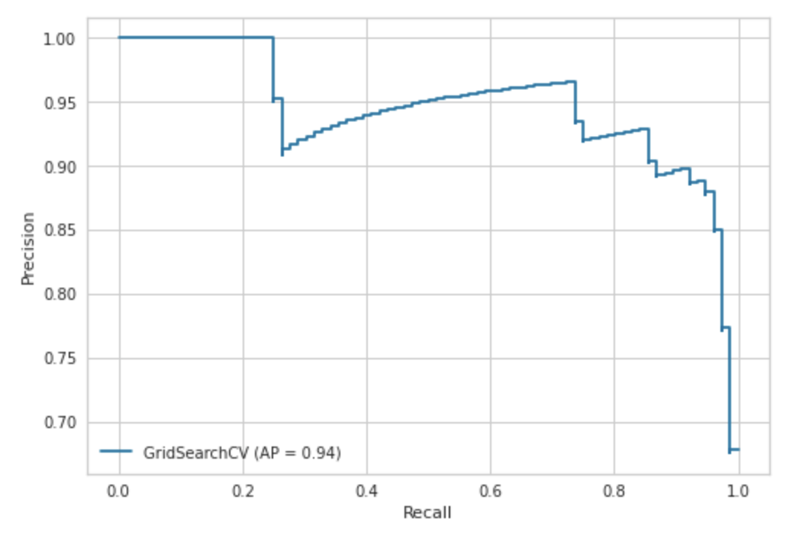
ROC (Receiver Operating Curve) and AUC (Area Under Curve)
SVM is a powerful algorithm that is widely used in many domains, including image classification, text classification, and bioinformatics. However, it is also a complex algorithm that requires careful tuning of hyperparameters and kernel functions to achieve optimal performance.

Slide 59
03. Decision Tree (DT)
Gather and pre-process data: Collect a labelled dataset and pre-process the data to ensure that it is clean and ready for use in training a decision tree model.
Split the dataset: Split the dataset into a training set and a testing set. The training set will be used to train the decision tree model, and the testing set will be used to evaluate the performance of the model.
Choose the split criterion: The split criterion is a key component of the decision tree algorithm, as it is used to determine which feature to split on at each node of the tree. There are different types of split criteria, such as Gini impurity and entropy, which measure the impurity of the classes in the data.
Train the decision tree model: Train the decision tree model on the training set by recursively splitting the data based on the chosen split criterion, until the leaf nodes are pure (i.e., contain only samples from one class).
Evaluate the performance: Evaluate the performance of the decision tree model on the testing set by computing metrics such as accuracy, precision, recall, and F1-score. These metrics provide a measure of how well the model is able to classify the testing data.
Tune the hyperparameters: Fine-tune the hyperparameters of the decision tree model, such as the maximum depth of the tree, the minimum number of samples required to split a node, and the minimum number of samples required to be at a leaf node, to improve the performance of the model.
Make predictions: Once the decision tree model is trained and tuned, it can be used to make predictions on new, unseen data by traversing the tree and making decisions based on the learned rules.

Slide 60
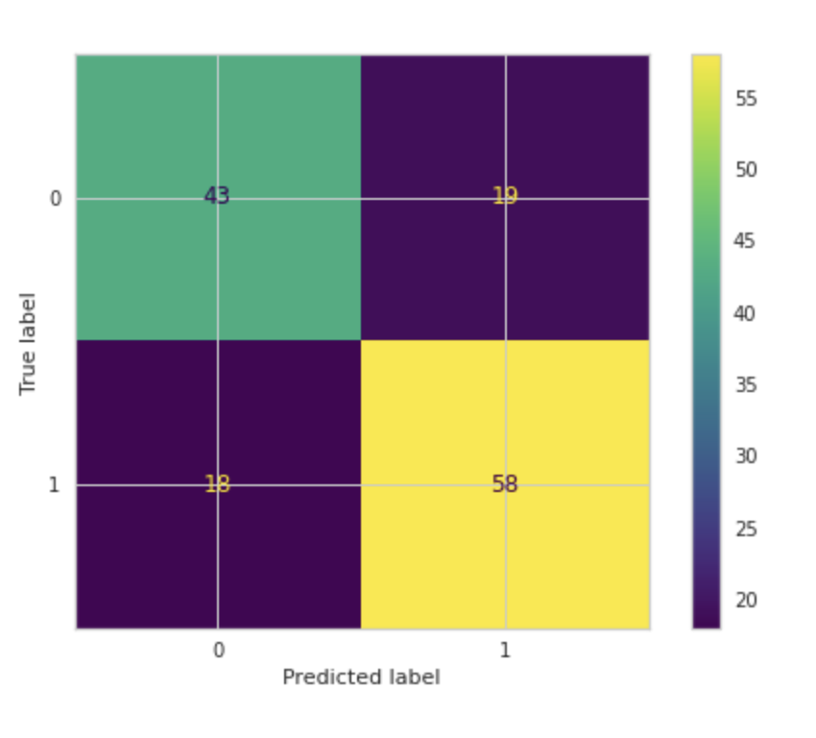
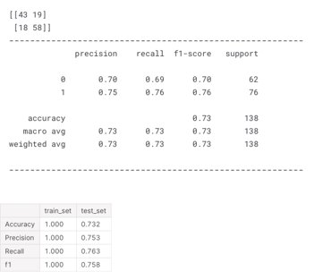
Modelling Decision Tree (DT) with Default Parameters

Slide 61


Cross-Validating Decision Tree (DT)

Slide 62


Modelling Decision Tree (DT) with Best Parameters Using GridSeachCV

Slide 63

Feature Importance for Decision Tree (DT) Model
The feature that weighs too much on the estimation can SOMETIMES cause overfitting. We are curious about what happens to our model if we drop the feature with contribution. For this reason, the most important feature will be dropped, and the scores will be checked again.

Slide 64


In general, droping the feature that weighs too much on the estimation did NOT make any sense. Both True Positive predictions and False Negative ones increadably decreased.

Slide 65


ROC (Receiver Operating Curve) and AUC (Area Under Curve)
Decision trees are a simple and interpretable algorithm that can handle both numerical and categorical data. However, they are also prone to overfitting if the tree is too deep or if the hyperparameters are not carefully tuned. Therefore, it's important to use techniques such as pruning and cross-validation to prevent overfitting and achieve optimal performance.

Slide 66
04. The Implementation of Random Forest (RF)
Gather and pre-process data: Collect a labelled dataset and pre-process the data to ensure that it is clean and ready for use in training a random forest model.
Split the dataset: Split the dataset into a training set and a testing set. The training set will be used to train the random forest model, and the testing set will be used to evaluate the performance of the model.
Choose the number of trees: The number of trees is a key hyperparameter of the random forest algorithm, as it determines the number of decision trees that are used to classify the data. Typically, increasing the number of trees will lead to better performance, but at the cost of longer training time.
Train the random forest model: Train the random forest model on the training set by building multiple decision trees using a random subset of the features and samples. This randomness helps to reduce overfitting and improve the performance of the model.
Evaluate the performance: Evaluate the performance of the random forest model on the testing set by computing metrics such as accuracy, precision, recall, and F1-score. These metrics provide a measure of how well the model is able to classify the testing data.
Tune the hyperparameters: Fine-tune the hyperparameters of the random forest model, such as the maximum depth of the trees, the minimum number of samples required to split a node, and the minimum number of samples required to be at a leaf node, to improve the performance of the model.
Make predictions: Once the random forest model is trained and tuned, it can be used to make predictions on new, unseen data by aggregating the predictions of the individual decision trees.

Slide 67


Modelling Random Forest (RF) with Default Parameters

Slide 68


Cross-Validating Random Forest (RF)

Slide 69


Modelling Decision Tree (DT) with Best Parameters Using GridSeachCV

Slide 70


Feature Importance for Decision Tree (DT) Model
Let’s compare the results with the ones found via Decision tree

Slide 71


ROC (Receiver Operating Curve) and AUC (Area Under Curve)

Slide 72

The Visualization of a Tree

Slide 73
05. The k-Nearest Neighbour (k-NN) classifier
Collect your dataset: You will need a dataset with labelled examples of the class you want to classify. The dataset should be split into training and testing sets. The training set will be used to train the model, while the testing set will be used to evaluate the performance of the model.
Normalize the data: Normalize the data to ensure that all features are on the same scale. This step is crucial to prevent certain features from dominating others in the calculation of distances.
Choose the value of k: Choose a value for k, which is the number of nearest neighbours to consider. A good rule of thumb is to use an odd number for k to avoid ties.
Calculate distances: Calculate the distance between the test point and all the training points in the dataset. The most common distance metrics used are Euclidean distance and Manhattan distance.
Find the k-nearest neighbours: Select the k-nearest neighbours to the test point based on the distances calculated in the previous step.
Assign a class: Assign a class to the test point based on the most common class among the k-nearest neighbours. For example, if the majority of the k-nearest neighbours are of class A, then the test point is assigned to class A.
Evaluate the model: Evaluate the performance of the model using the testing set. Common performance metrics for classification problems are accuracy, precision, recall, and F1 score.
Tune hyperparameters: Experiment with different values of k and other hyperparameters to improve the performance of the model.

Slide 74


Modelling K-Nearest Neighbour (KNN) with Default Parameters

Slide 75

Cross-Validating K-Nearest Neighbour (KNN)

Slide 76

Elbow Method for Choosing Reasonable K Values

Slide 77


GridsearchCV for Choosing Reasonable K Values

Slide 78


GridsearchCV for Choosing Reasonable K Values

Slide 79


ROC (Receiver Operating Curve) and AUC (Area Under Curve)

Slide 80

THE COMPARISON OF MODELS

Slide 81
CONCLUSION
In this study respectively,
We have tried to a predict classification problem in Heart Disease Dataset by a variety of models to classify Heart Disease predictions in the context of determining whether anybody is likely to get hearth disease based on the input parameters like gender, age and various test results or not.
We have made the detailed exploratory analysis (EDA).
There have been NO missing values in the Dataset.
We have decided which metrics will be used.
We have analysed both target and features in detail.
We have transformed categorical variables into dummies so we can use them in the models.
We have handled with skewness problem for make them closer to normal distribution; however, having examined the results, it's clear to assume that handling with skewness could NOT make any contribution to our models when comparing the results obtained by LogisticClassifier without using PowerTransform. Therefore, in this study we have continue not handling with skewness assuming that it's useless for the results.
We have cross-checked the models obtained from train sets by applying cross validation for each model performance.
We have examined the feature importance of some models.
Lastly, we have examined the results of all models visually with respect to select the best one for the problem in hand.

Slide 82


